Slide 1
Skill Based Adaptive Routing and Reading Component Assessment
Kentaro Yamamoto, ETS
June 2013

Slide 2
PIAAC Main Study Yield
(weighted average of 22 countries)16-65 PIAAC samples
ICT use from BQ
1.9% (Missing BQ and
cognitive data)
1.7% (Missing cognitive
data)
No computer experience
9.2%
Some computer experience
87.2%
Paper Branch
Fail
4.1%
CBA-Core
Stage 1: ICT
Computer Branch
CORE
4L + 4N
Pass 72.8%
Refused CBA
10.2%
CBA-Core
Stage 2: 3L + 3N
Fail
Pass
Pass
11.0%
10.8%
0.6%
Pass
1.7%
LITERACY
20 Tasks
LITERACY
20 Tasks
LITERACY
Stage 1 (9 tasks)
Stage 2 (11 tasks)
NUMERACY
Stage 1 (9 tasks)
Stage 2 (11 tasks)
PS in TRE
Fail
5.3%
5.4%
20.0%
5.6%
5.5%
10.6%
20.1%
READING
COMPONENTS
NUMERACY
Stage 1 (9 tasks)
Stage 2 (11 tasks)
LITERACY
Stage 1 (9 tasks)
Stage 2 (11 tasks)
PS in TRE
Notes:
Everyone taking the literacy and numeracy domains are on the same scale.
For problem solving, we only have data for a percentage of people.
The overall conclusion is that this is really good quality data. Over 98% of the people who agreed to take the test did so and we have data for them
The workflow worked in the way it was designed to work. The only exception was the 10% refusal that was not really planned.

Slide 3
Age Distributions of Respondents by Subgroups
Percentage of Respondents
Age
Notes:
These are now the two additional groups.
What was interesting to us is that the people who refused are similar to the people who failed the ICT core. This is further evidence that the people who self-selected themselves are similar to those who actually failed.
It is also clear that they varied by group

Slide 4
Education Distribution of Respondents by Subgroups
Notes:
This is similar information by level of education and again, it makes sense.

Slide 5
Routing of Respondent by ICT Relevant Skill Requirement
 | country A |  | country B |  | country C |  | country D |  | country E
 | mean | % | mean | % | mean | % | mean | % | mean | %
No computer experience | 225 | 25 | 227 | 10 | 200 | 5 | 223 | 4 | 255 | 10
Failed ICT core | 220 | 3 | 234 | 5 | 230 | 4 | 235 | 5 | 298 | 11
Refused CBA | 255 | 15 | 262 | 18 | 247 | 7 | 269 | 10 | 293 | 16
CBA | 261 | 58 | 276 | 68 | 278 | 84 | 296 | 81 | 303 | 63
Total | 250 | 100 | 267 | 100 | 270 | 100 | 288 | 100 | 296 | 100

Slide 6
Multiple Levels of Adaptation
Successful adaptations in terms of administering appropriate instrument for most efficient and accurate measurement.
Self reported ICT skills
ICT skills evaluation
Willingness to proceed to CBA
Multiple stages within cognitive assessment
Within CBA
Within PBA

Slide 7
Three Reading Components are Measured
The reading components measures are designed to provide information about what adults in Levels 1 & 2 can do in the building blocks of literacy proficiency.
Word Meaning (Print Vocabulary) measures the extent to which participants can recognize the printed forms of common objects.
Sentence Processing measures the extent to which participants can comprehend sentences of varying levels of complexity.
Basic Passage Comprehension measures the extent to which participants can comprehend the literal meaning of connected text.

Slide 8
Print Vocabulary example1

Slide 9
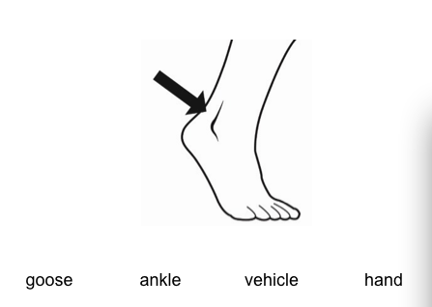
Print Vocabulary example2

Slide 10
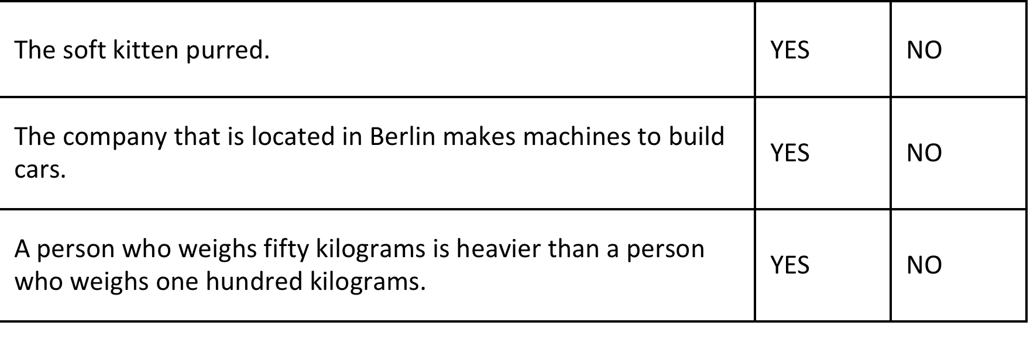
Sentence Processing Example1

Slide 11
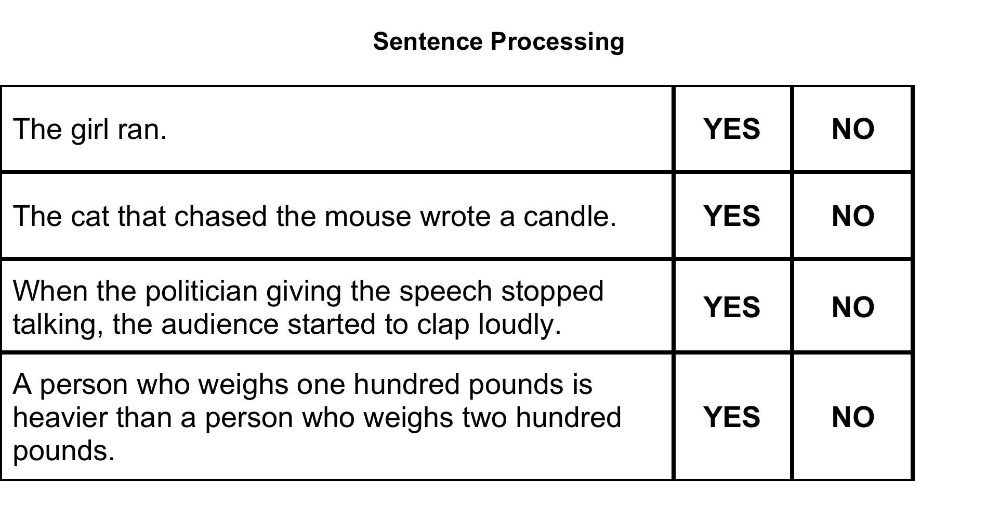
Sentence Processing Example 2

Slide 12
Passage Comprehension Example 1

Slide 13
Passage Comprehension Example 2
Chess
One of the oldest games in the world is chess, in which players move pieces around a checkered board. Most experts agree that chess
originated / attempted in India over a thousand years ago. There is, however, another theory that China is the birthplace of the weight / game. Wherever it was invented, chess gradually spread to the Middle East and southern Europe as well as to other hospitals / countries, such as Russia. It remains very popular around the world / box today.
The rules of the modern game of chess were developed about five hundred years ago and dictate how the pieces can move. Since then, chess tournaments have arisen with the purpose of determining a world chess dinner / champion. In the last half of the 20th century, players from the former Soviet Union dominated the bridge / game. Many people were shocked in 1997 when a computer program beat the reigning world decision / champion. But there was much controversy surrounding the win, and the company that made the program disassembled it soon after the match / wheel.

Slide 14
Reading Component Items Are Easy for Everyone
Components | Items | P+
Vocabulary | 34 | 97.4
Sentence | 22 | 91.4
Passage (4) | 44 | 92.7

Slide 15
Average Timing for Reading Components
Block | Mean (min) | SD
Vocabulary | 1.62 | 0.19
Sentence | 2.04 | 0.32
Passage 1 | 1.92 | 0.32
Passage 2 | 1.16 | 0.20
Passage 3 | 0.97 | 0.18
Total | 7.71 | 1.13

Slide 16
Reading Components Accuracy on the Literacy Scale

Slide 17
Reading Components Fluency on the Literacy Scale

Slide 18
Reading Components Accuracy on the Literacy Scale; different orthography

Slide 19
Reading Components Fluency on the Literacy Scale

Slide 20
Summary of Reading Components Analysis
Respondents worked through RC items more quickly than expected by 2.25 min. However, for among least able respondents (less than 17th percentile), average time was 9.87 minutes.
Most able group in every country converged to about 3 seconds per item for vocabulary tasks.
P+ differentiated component skills of PIAAC respondents rather well for respondents with low skills.
Timing provided additional information to characterize skills measured by PIAAC.
Fluency while correlated with Accuracy adds to our understanding of component skills.

